Slide 1

Distributed System Challenges
Notes:
Trendyol Presentation Template & Slides için link
L&D Training Slide Template’i kullanarak slidelarımızı oluşturalım :)

Slide 2




c
PURPOSE
Understand challenges of distributed systems
WHY
Find better solutions for our problems

Slide 3


AGENDA
1
Talk about challenges
2
Real life examples
3
Q&A

Slide 4
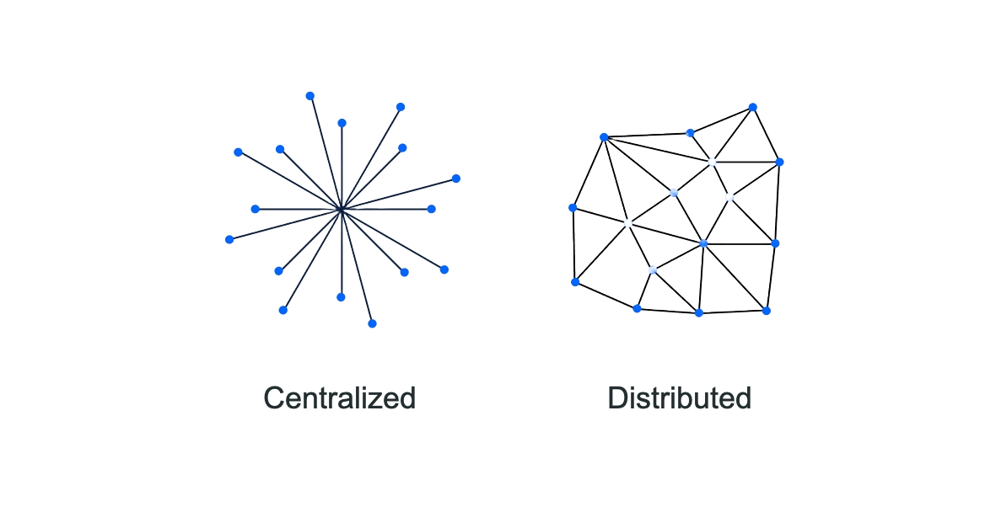


Slide 5
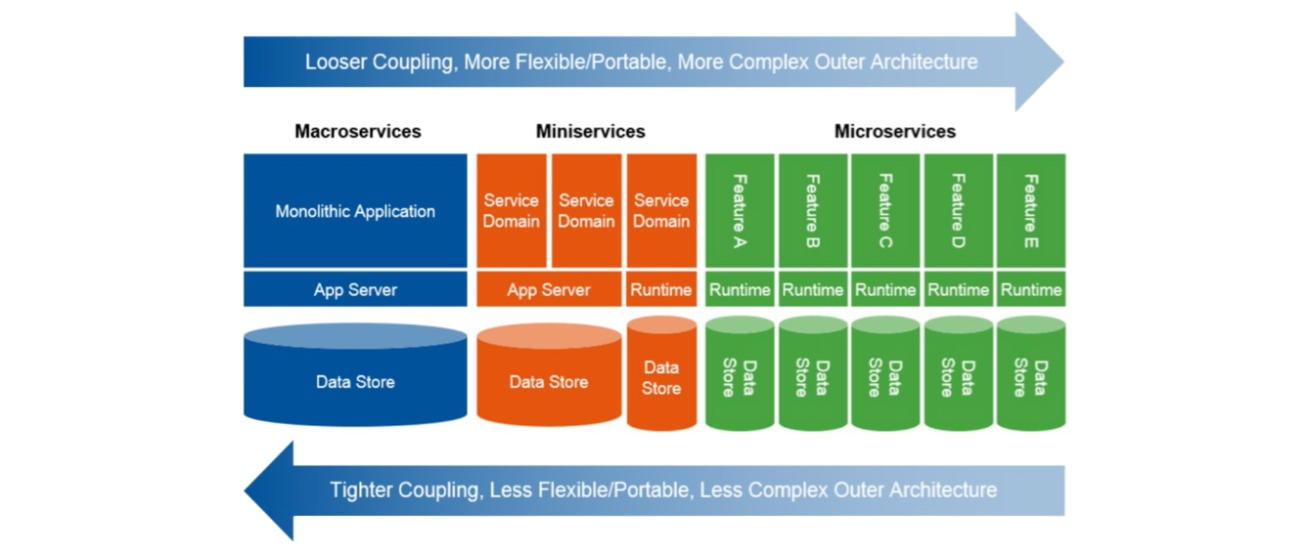


Slide 6
TOPİCS
Scalability
Latency
Concurrency
Security
Failure Handling
Observability - Monitoring

Slide 7
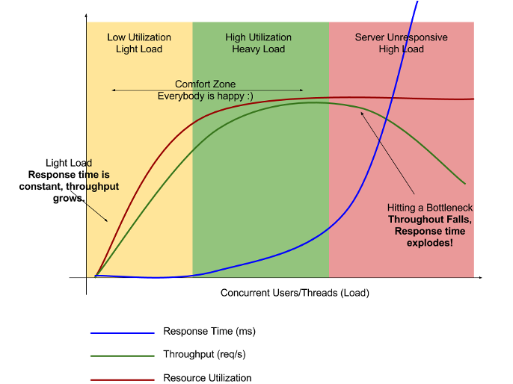

SCALABILITY
Means system’s performance with increasing load
There are two parameters to measure it; throughput and response time

Slide 8

SCALABILITY - PROBLEMS
Cpu
Memory
Network
Caching
Code Implementation

Slide 9

SCALABILITY - SOLUTIONS
Scale up
Scale out
Auto scaling tools
Rate Limiting
Circuit Breaking
Alerts

Slide 10
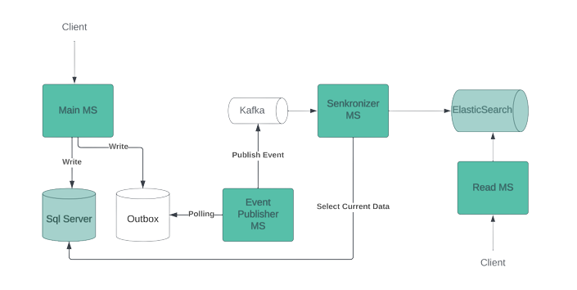
SCALABILITY - EXAMPLE

Slide 11
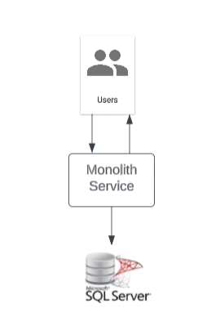
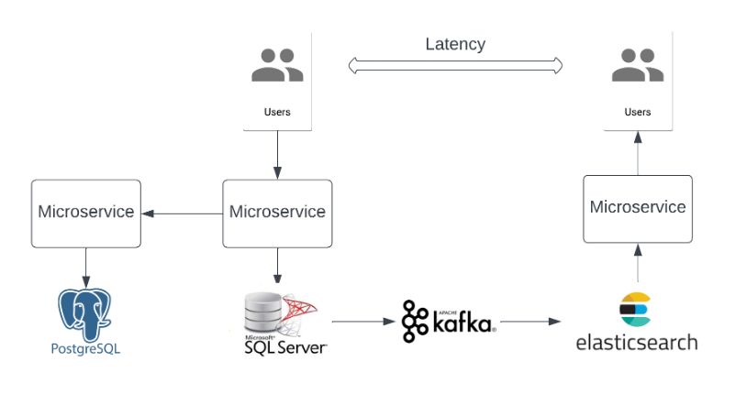
LATENCY
Time required to transmit a message from one location to another within a distributed system

Slide 12
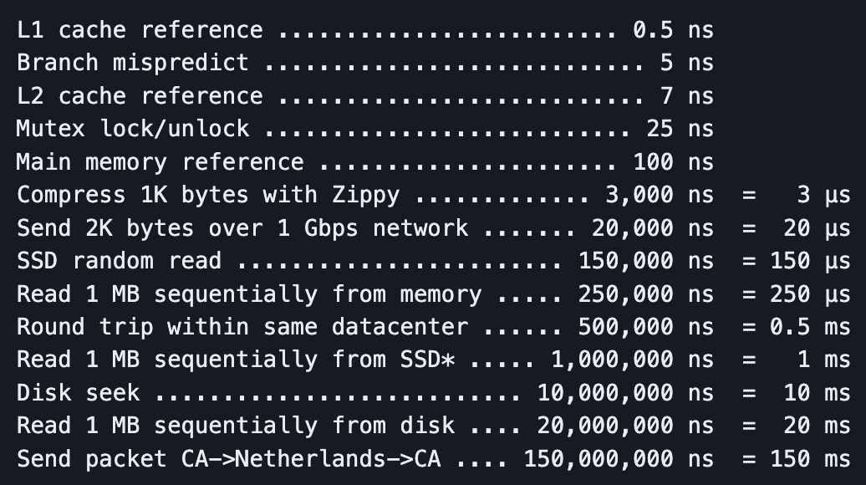
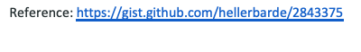
LATENCY - NUMBERS

Slide 13
LATENCY - SOLUTIONS
Non blocking approach
In-memory cache
Lower sync read replica count on database
Lower replication factor on messaging queue
Lower refresh interval time on search engine

Slide 14
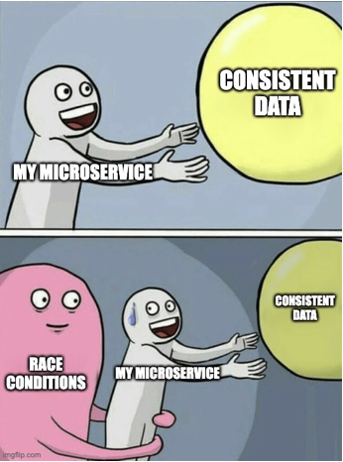
CONCURRENCY
Mean is ability to process data parallely on different nodes of the system
If we don’t manage concurrency correctly, race conditions will happen which means that the data produced is in wrong state

Slide 15
CONCURRENCY - SOLUTIONS
Make idempotent your operations as much as possible
Read data from source of truth instead of replicated source
Use RDBMS databases on write operations
Use versioning on data
Put partition key to events to ensure order

Slide 16
SECURITY - PROBLEMS
Use a gateway or backend for frontend to handle incoming requests from outside
Service discovery helps to services to call each other inside same cluster
without any security risk
Service to service authorization can improve security when we use with service discovery

Slide 17
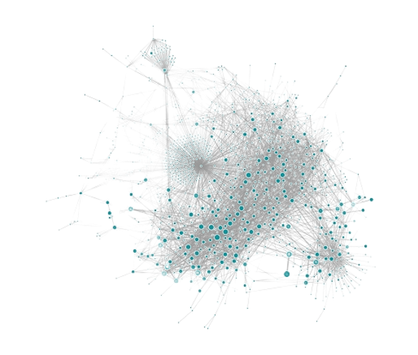

FAILURE HANDLING
Failures can cause cascading effect on microservice architecture
Although easy to find and recover errors on monolith application, distributed systems need extra precaution and preparation

Slide 18
FAILURE HANDLING - SOLUTIONS
Logging and alerting mechanism should show every details on critical paths
Async communication (message based) will be better between microservices
instead of sync RPC calls
Circuit breaker patterns are useful to avoid infinite calls
Put exponential backoff on retries
Using timeouts ensures that threads are never blocked indefinitely
Health-check and load balancing will help to route requests to healthy pods
Saga or 2PC patterns ensures data consistency when error happen on somewhere of process

Slide 19
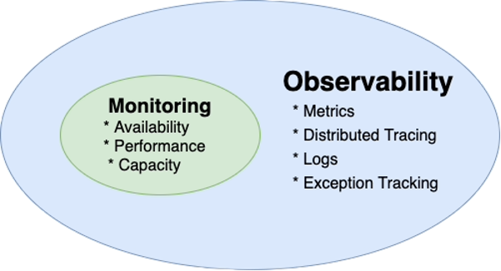
OBSERVABILITY AND MONITORING
Observability is the ability to measure the internal state of a system only by its external outputs
It’s vital to keep microservices healthy and resilient

Slide 20
OTHER CHALLENGES
Operational Complexity
Cognitive Load
Integration Tests
Deployments

Slide 21

Because there are no gain without sacrifice

Slide 22

THANK YOU

